Slide 1

Superintendent’s Proposed Budget 2025-2026
      Dr. John B. Gordon III, Superintendent
      Mrs. Wendy K. Forsman, Chief Financial Officer
      February 27, 2025
Notes:
Put your notes here

Slide 2
Agenda
      Budget Timeline: Process and Input
      Strategic Plan 2028
      Proposed Budget Challenges
      Unfunded Needs
      Structure of the Budget Book
      Proposed Budget by Category
Notes:
Put your notes here

Slide 3
Budget Process Overview
      School Administrators - September
      School Staff/Board - September/October
      Public Stakeholders - December and March
      Directors/Coordinators - November
      Superintendent/Chiefs - December/January
      School Board Members - February/March
Notes:
Put your notes here

Slide 4
Budget Process Overview
      School Board/City Council -April/May
      School Board -May/June
Notes:
Put your notes here

Slide 5
Common Themes from STAKEHOLDER INPUT
      Safety of Students and Staff
      Student Growth and Literacy
      Raises/Pay
Notes:
Put your notes here

Slide 6
STRATEGIC PLAN 2028
      STUDENT ACHIEVEMENT:
English Language Learner Teachers (3) | Academic Coach - KFMS
Reading Specialist –FBES | VA Literacy Act
Dual Enrollment | Saturday Academy
Summer School | Regional Tuition
In-person Tutoring | Literacy/Math Software
Notes:
Put your notes here

Slide 7
STRATEGIC PLAN 2028
      CLIMATE & CULTURE:
Additional School Resource Officers (11) | Zero Eyes Security
Improving Transportation Staffing Specialist -HR | Athletic Trainers
Notes:
Put your notes here

Slide 8
STRATEGIC PLAN 2028
      HUMAN & FISCAL RESOURCES:
RAISES 3%-3.5%
Starting TEACHER’S SALARY $56,975
( Note: staff/admin/bus drivers and teachers at the top of the scale receive a COLA increase)
Increased costs of operations –INFLATIONARY increases
Increased budget for Attorney services
Notes:
Put your notes here

Slide 9
History of Teacher Raises
2021-2022 | $46,350 to $77,641
2022-2023 | $49,316 to $82,610
2023-2024 | $53,000 to $85,706
2024-2025 | $55,141 to $90,122
Proposed 2025-2026 | $56,975 to $91,248
23% over 5 years
Notes:
Put your notes here

Slide 10
Proposed Budget Challenges
Governor’s Proposed Budget –minimal increase
Virginia Literacy Act unfunded mandates
Governor’s All –In grant funding cliff
Cost of Transportation –Special Education Students
Inflation
Notes:
Put your notes here

Slide 11
State All – In Grant ($5.8M)- Ends 6/30/25
Tutoring, Attendance, and Literacy:
Tutoring in person and virtual
Saturday Academy
Incentives for Attendance
Personnel for Attendance support
Literacy Coaches and programs
Summer School beyond remedial state money
CANVAS –learning management system
Notes:
Put your notes here

Slide 12
Unfunded Needs - Instructional
Virtual Instruction/Tutoring | $1,200,000
Additional ELL Teachers | 254,508
Additional Teachers (MS and HS) | 254,508
Additional Teacher Assistants | 160,000
Additional School Counselors | 217,240
Science Specialist | 125,000
Additional Pre-K Classroom | 184,836
Notes:
Put your notes here

Slide 13
Unfunded Needs – other
Middle School Baseball/Softball | $1,200,000
Additional Clerical | 36,852
Additional ITRTs | 84,836
Computer/Telephone replacement | 350,000
Replacement Copiers/desks/buses | 2,500,000
Increasing maintenance aging schools | 1,000,000
Notes:
Put your notes here

Slide 14
Unfunded Needs
Total Unfunded needs
$7,567,780
Notes:
Put your notes here

Slide 15
Proposed Budget Structure
      Wendy K. Forsman, Chief Financial Officer
Notes:
Put your notes here

Slide 16
Structure of the Budget Book
Organizational Information and Legal requirements
Executive Summary
Expenditures by Program
Glossary of terms
Notes:
Put your notes here

Slide 17
Structure of the Budget Book
Titles on Program Pages indicate the 7 categories defined by the state
All expenditures are placed in the program/expenditure category state defined
Certain Programs are further broken down by level
Non-Departmental Items are allocated AFTER expensed each year
Notes:
Put your notes here

Slide 18
Structure of the Budget Book
COLUMNS
ACTUAL 2023-2024
REVISED 2024-2025
PROPOSED 2025-2026
% INC/DECR
Notes:
Put your notes here

Slide 19
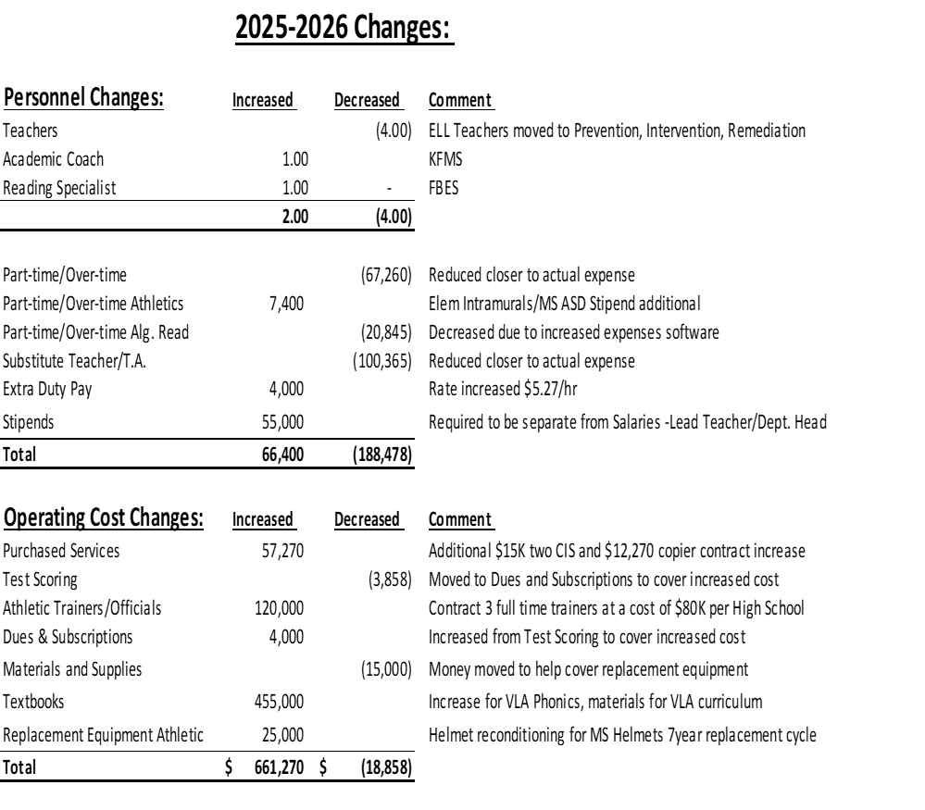
Structure of the Budget Book
Notes:
Put your notes here

Slide 20
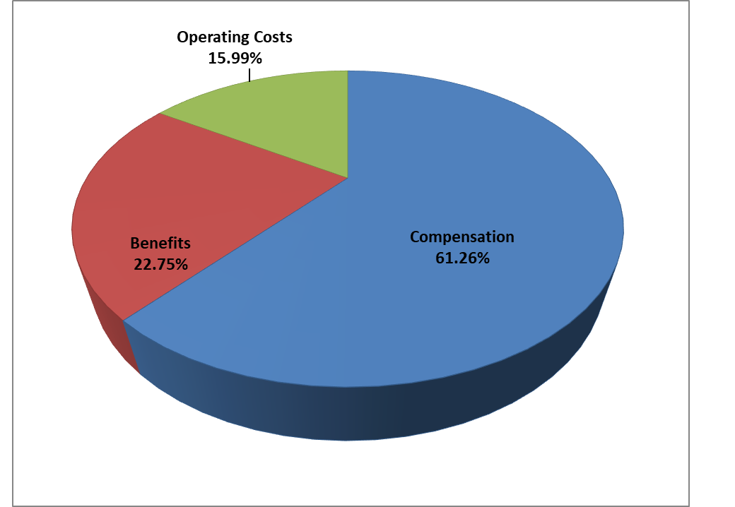
Structure of the Budget
Compensation and Benefits 84.01% of Total Operating Budget
Notes:
Put your notes here

Slide 21
2025-2026 Proposed Budget
Total Operating Budget | $214,179,255
Salary and Benefits | 179,919,762
Operating Costs Budget | 34,259,493
16% of Budget
Notes:
Put your notes here

Slide 22
2025-2026 Superintendent’s Proposed Budget
 | 2023-2024 Actual | 2024-2025 Revised | 2025-2026 Proposed | % Inc./(Decr.)
Expenses By Fund:
Operating Fund | $187,503,293 | $204,027,374 | $214,179,255 | 4.98%
Grants Fund | 34,024,881 | 34,220,000 | 20,015,000 | -41.51%
Food Services Fund | 10,015,734 | 10,341,554 | 10,359,819 | 0.18%
Total | $231,543,908 | $248,588,928 | $244,554,074 | -1.62%
Notes:
Put your notes here

Slide 23
Teachers/Support Staff/Bus Drivers
  State mandated 3% raise
  Superintendent’s Proposed Budget:
  3% -3.5% based on experience step
  *Note: Employees at the top of the scale will receive COLA portion only
Notes:
Dr. JBG3

Slide 24
Additional Positions:
ELL Teachers, Academic Coach, Reading Specialist | 5.00
Staffing Specialist –HR | 1.00
Custodial Vacancies (contracted) | (5.00)
P/T Reduction | (0.60)
Net Total Positions Added | 0.40
Notes:
Put your notes here

Slide 25
2025-2026 Governor’s Proposed
Governor Proposed Budget:
$3,208,761
Notes:
Put your notes here

Slide 26
2025-2026 City Request
City Investment request for additional:
Safety, Security
Student Achievement
Increased costs of operations
$7,000,000
Total City Funding of $82,332,201
Notes:
Put your notes here

Slide 27
2025-2026 City/State Breakdown
Increased Cost: | State | Local
Raise 3%-3.5%, state mandate, HR Recruiting Specialist | $2,326,090 | $3,379,274
Academic Coach – KFMS and Reading Coach –FBES |  | 184,740
ELL Teachers (3) | 254,508 | 9,600
VA Literacy Act Compliance | 63,312 | 546,639
Dual Enrollment increased costs |  | 19,000
Saturday Academy (grant funding ending) |  | 200,000
Summer School (grant funding ending) | 245,431
Before and After Tutoring (grant funding ending) |  | 500,000
Reduced Regional Tuition and TRAEP (state reducing annually) | (138,430) | 178,430
Software -VLA, IXL Reading/Math and Increased costs software |  | 281,647
Athletic Trainers Dedicated each HS |  | 120,000
11 Additional SRO's |  | 862,500
Zero Eyes Security |  | 100,000
Private Carriers - McKinney Vento and Special Education |  | 150,000
Cost of parts - Transportation (aging fleet) |  | 175,000
Net of Increased cost of operations (purchase contracts, maintenance contracts, travel/training, materials) due to inflation | 457,850 | 254,700
Legal services - Attorney |  | 38,470
Totals | $3,208,761 | $7,000,000
Notes:
Put your notes here

Slide 28
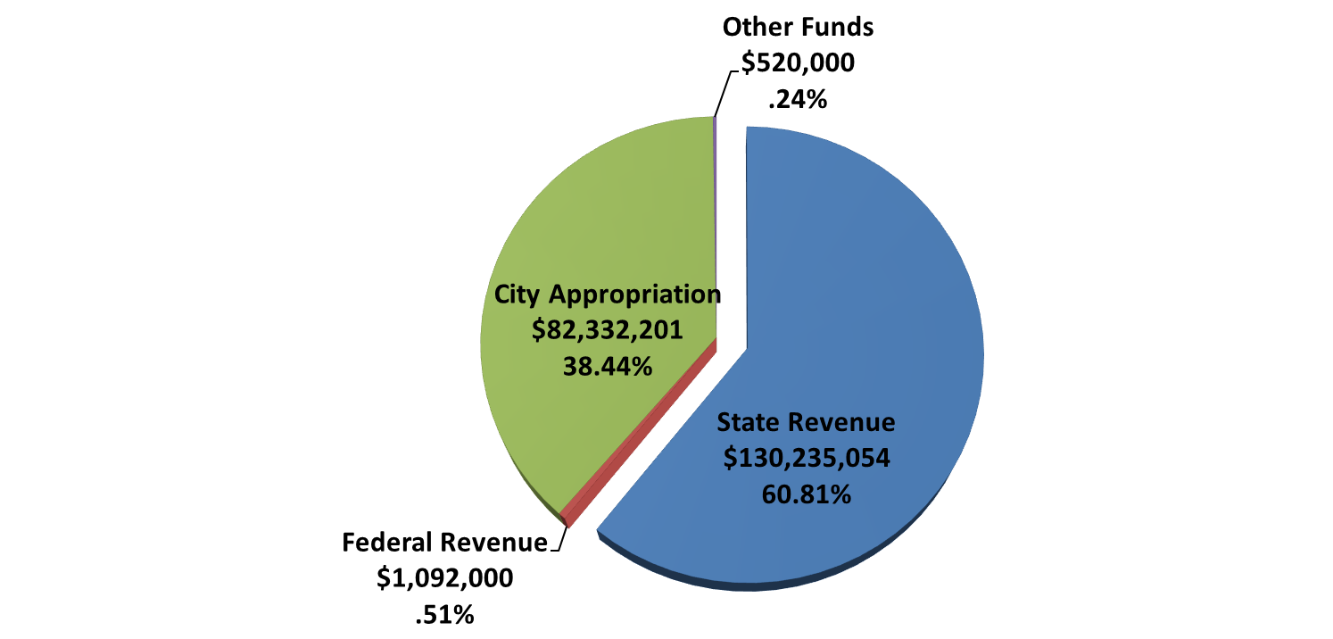
Operating Fund
Notes:
Put your notes here

Slide 29
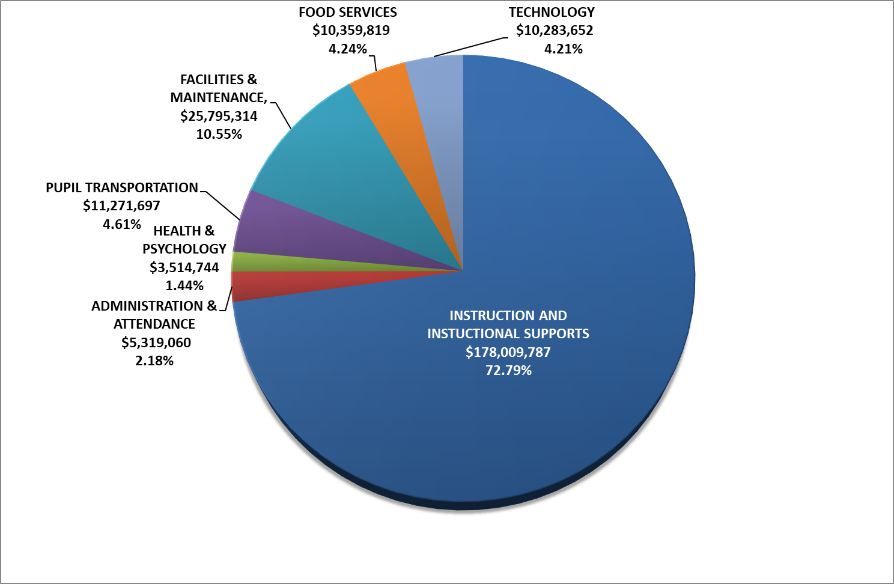
2025-2026 Proposed Budget
All Funds
Notes:
Put your notes here

Slide 30
Compensation Investments
Raise 3%-3.5% $5,705,364
Additional Positions 564,245
Non-Regular Day Programs 945,431
Subs/Part time/Stipends net 125,420
Compensation Increase $7,340,460
Notes:
Put your notes here

Slide 31
Operational Increases
SRO’s and Zero Eyes $962,500
Textbooks(Va Literacy Act) 455,000
Utilities/Insurance 422,132
Software increases/add on 296,584
Vehicle Parts 175,000
Notes:
Put your notes here

Slide 32
Operational Increases
Private Carriers 150,000
Athletic Trainers/Officials 122,000
Local Match Grants 100,000
Joint Operations Payments 40,000
Notes:
Put your notes here

Slide 33
Operational Increases
Legal Services contracted 38,470
Dual Enrollment Fees 19,000
Other Operational NET 30,735
Operational Costs Increase $2,811,421
Notes:
Put your notes here

Slide 34
Total Investment
Personnel $7,340,460
Operational 2,811,421
Total $10,151,881
Notes:
Put your notes here

Slide 35
Questions?
Ask a Budget Question located on the SPS website under Finance Department at www.spsk12.net
Notes:
Put your notes here

Slide 36
Superintendent’s Proposed Budget 2025-2026
      Dr. John B. Gordon III, Superintendent
      Mrs. Wendy K. Forsman, Chief Financial Officer
      February 27, 2025
Notes:
Put your notes here

